Slide 1
Marine Life Detection
A computer vision project using unsupervised and supervised machine learning
Abhi
18.04.2025

Slide 2
Overview
Motivation
Dataset Collection
Challenges
Unsupervised ML
Supervised ML & Computer Vision
Summary

Slide 3

Motivation
It all started with learning swimming

Slide 4
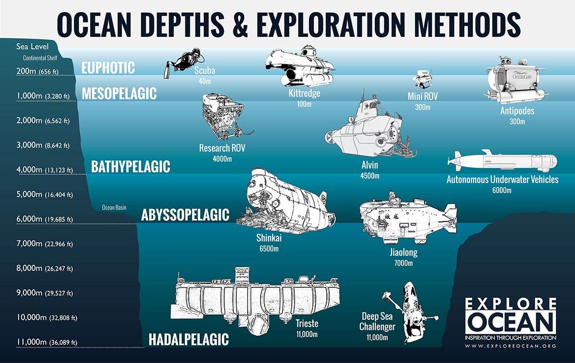
Motivation
It all started with learning swimming
80% of the world ocean is unexplored

Slide 5
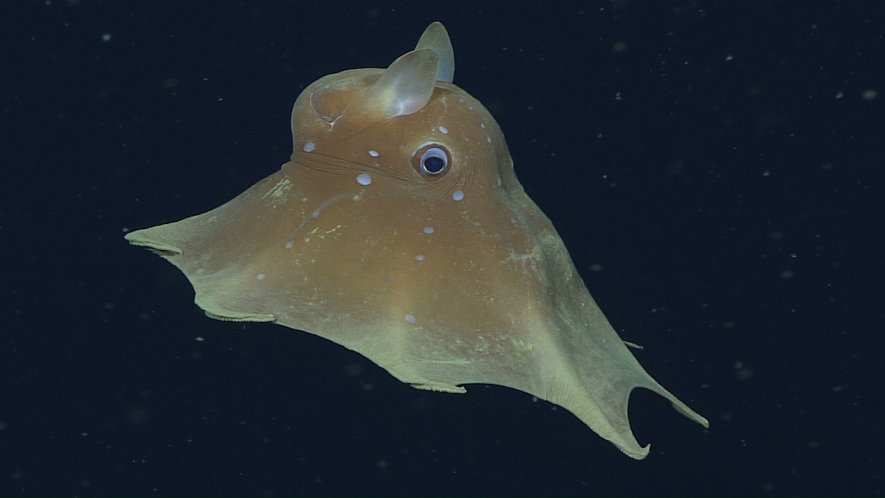
Motivation
It all started with learning swimming
80% of the world ocean is unexplored
Deep sea creatures are different

Slide 6
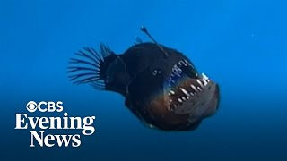
Motivation
It all started with learning swimming
80% of the world ocean is unexplored
Deep sea creatures are different
They are coming to the surface

Slide 7
Motivation
It all started with learning swimming
80% of the world ocean is unexplored
Deep sea creatures are different
They are coming to the surface
Can we identify the species?

Slide 8
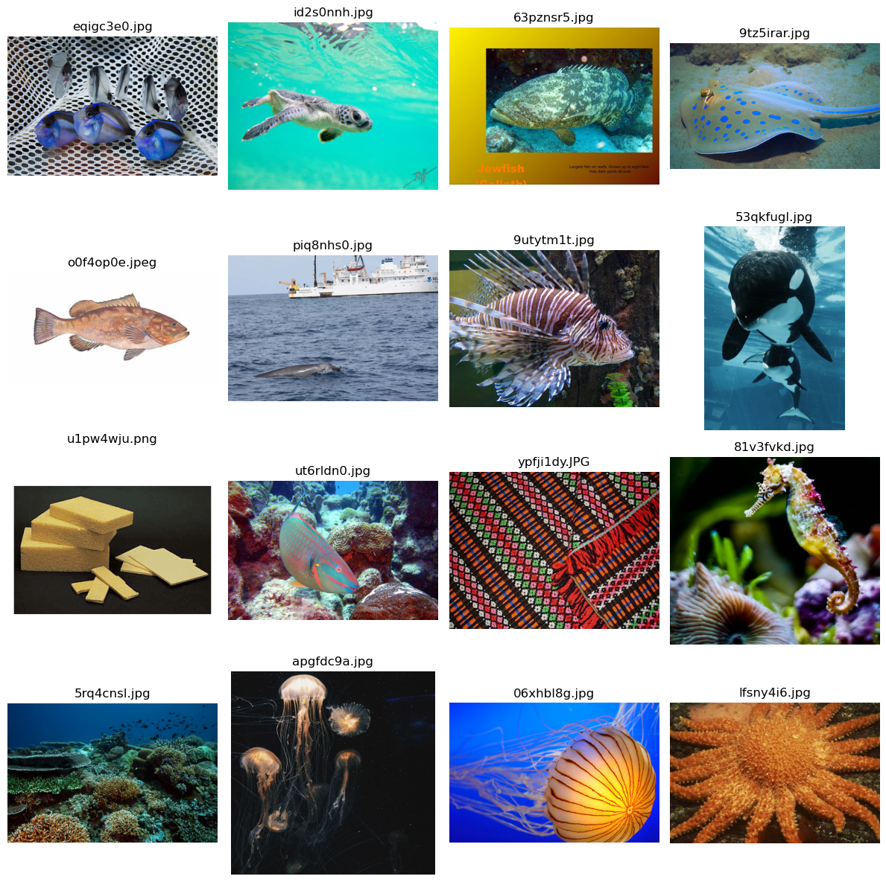
Dataset
Source: Kaggle
Contains sea animals + noise
Total: 7990 images

Slide 9
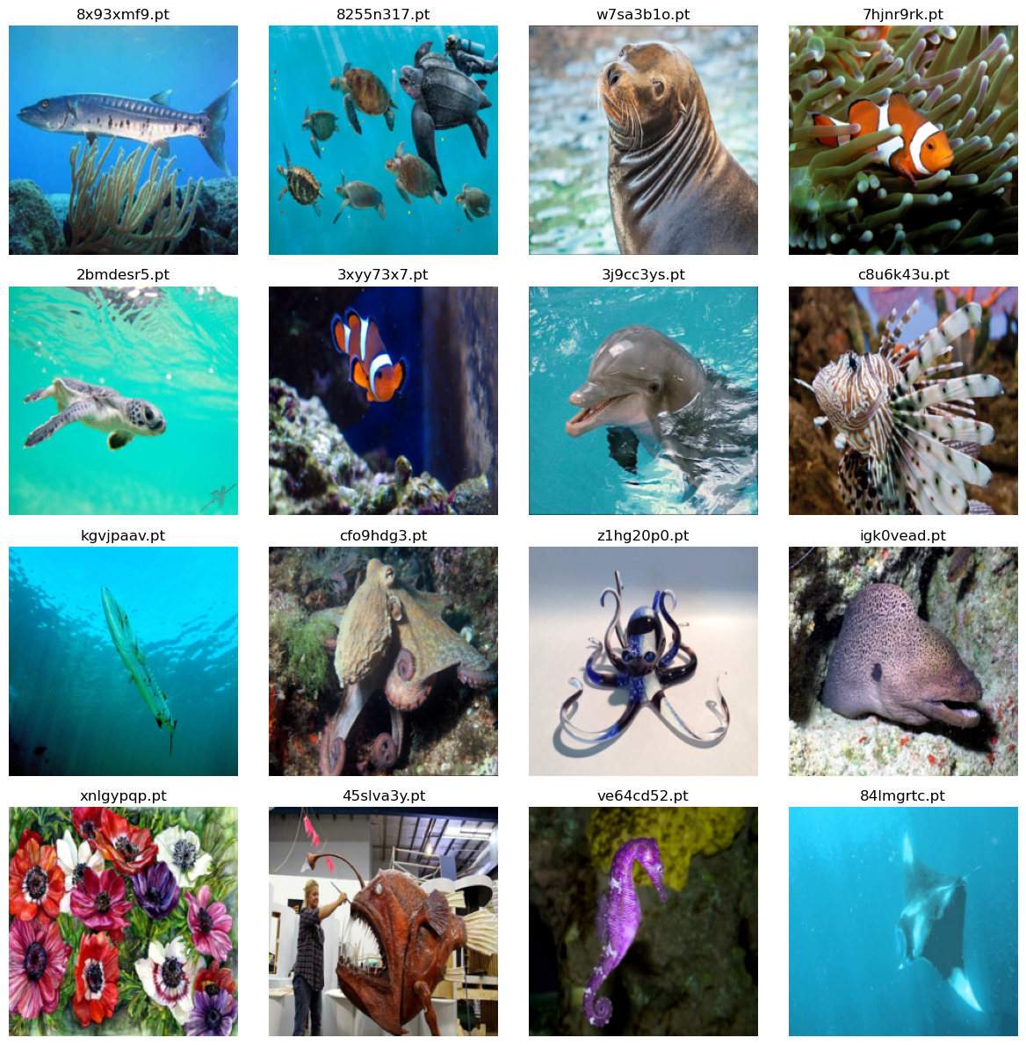
Dataset
Source: Kaggle
Contains sea animals + noise
Total: 7990 images
After processing: 7624 images

Slide 10
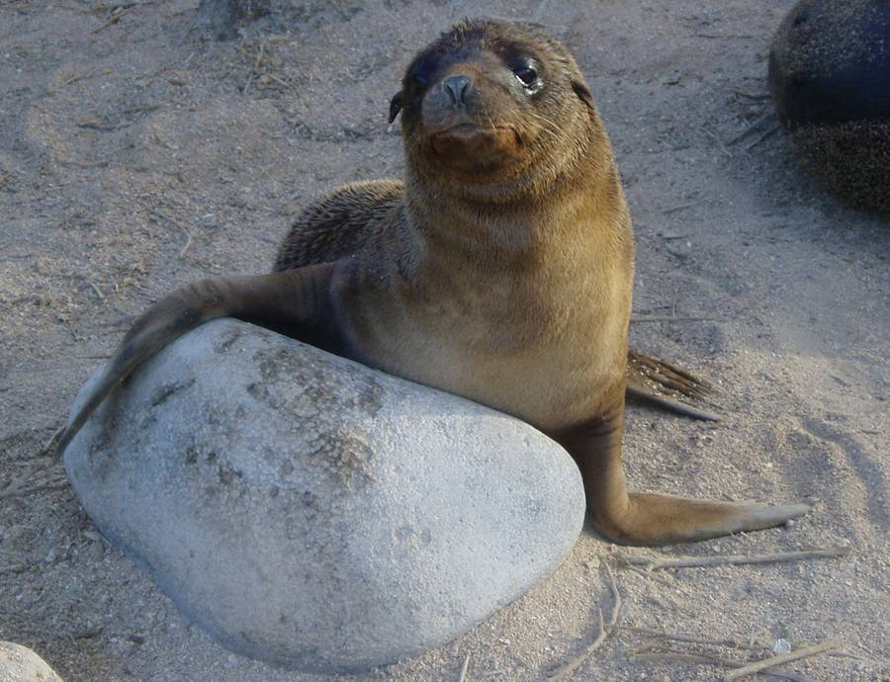
Challenges & Solution
How to classify the images into different clusters?
How to remove noises?
Unsupervised ML: K-means clustering
DBSCAN: To remove outlier
Label the cluster
Supervised computer vision

Slide 11
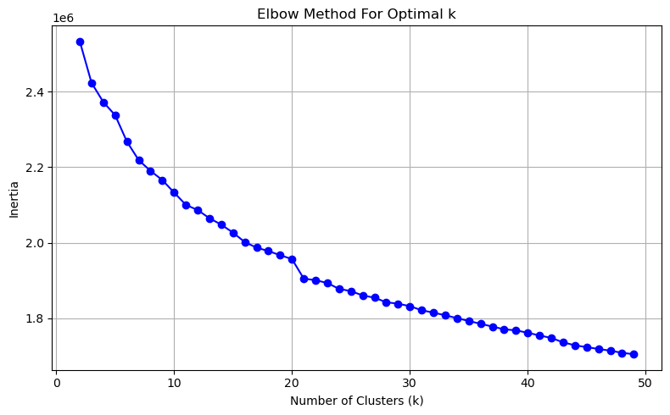
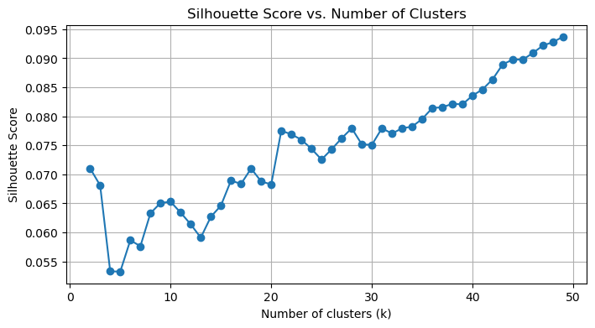
K-means clustering
K-means predicted 11 good clusters out of 21

Slide 12
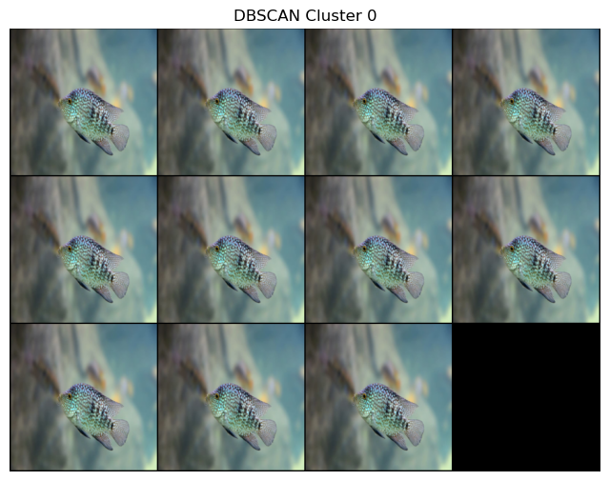
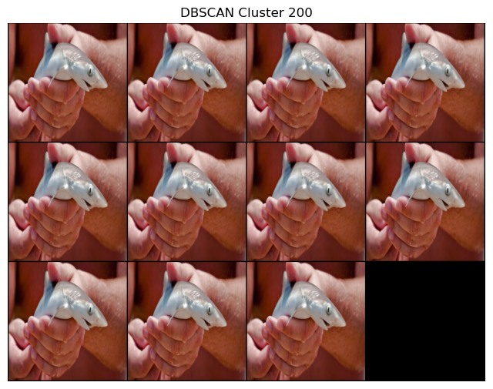
DBSCAN

Slide 13
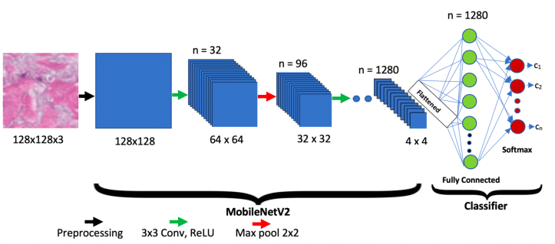
Model training
Computer vision model: MobileNetV2
Learning rate: 0.001
Adam optimizer
Batch size: 16
Data augmentation
Pretrained weights from Imagenet
Initial epoch: 30

Slide 14
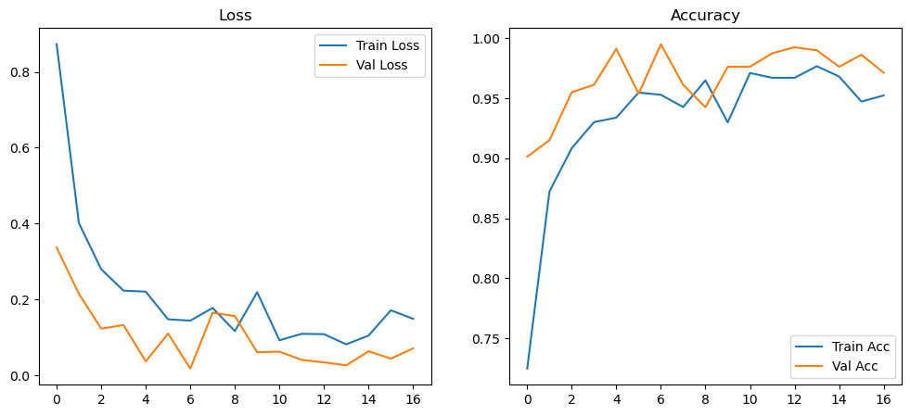
Metrics

Slide 15
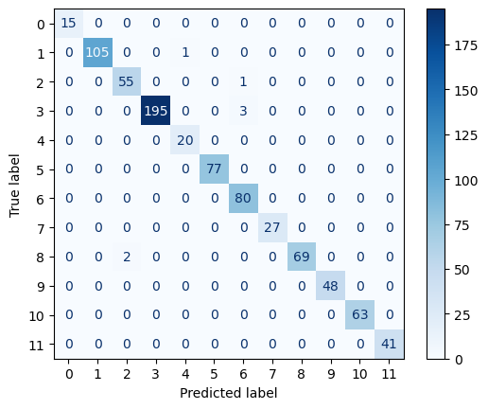
Confusion Matrix

Slide 16
SHOWTIME

Slide 17
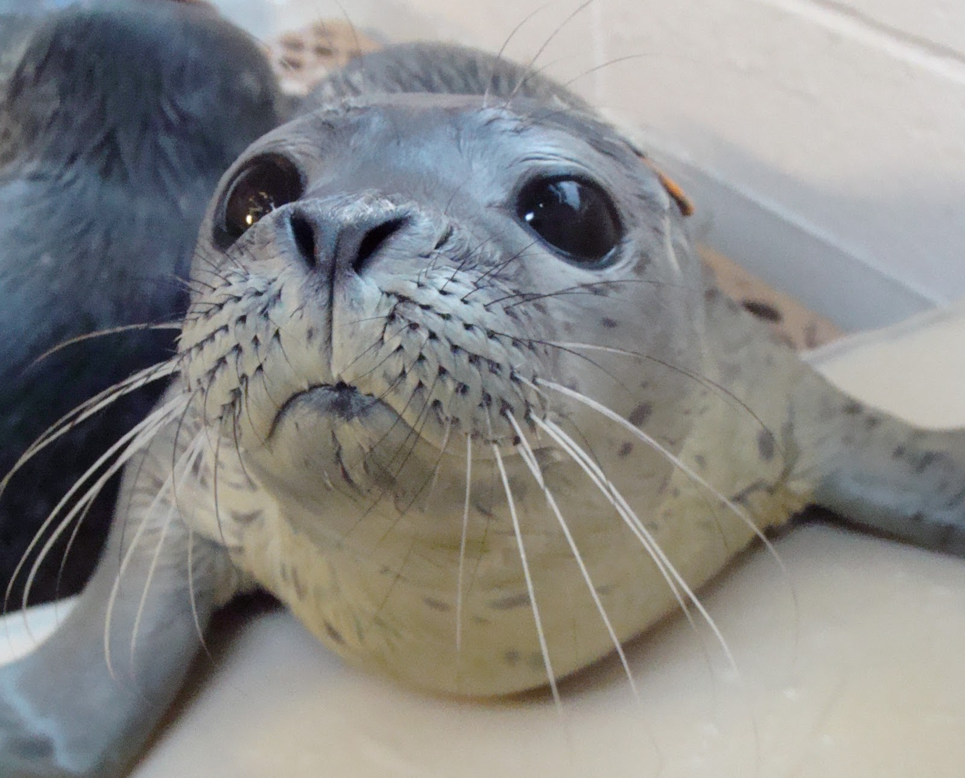
Thank you!
Any questions?

